Slide 1


“The most effective way to keep healthcare affordable is to stay healthy”
- Health Minister Gan Kim Yong

Slide 2
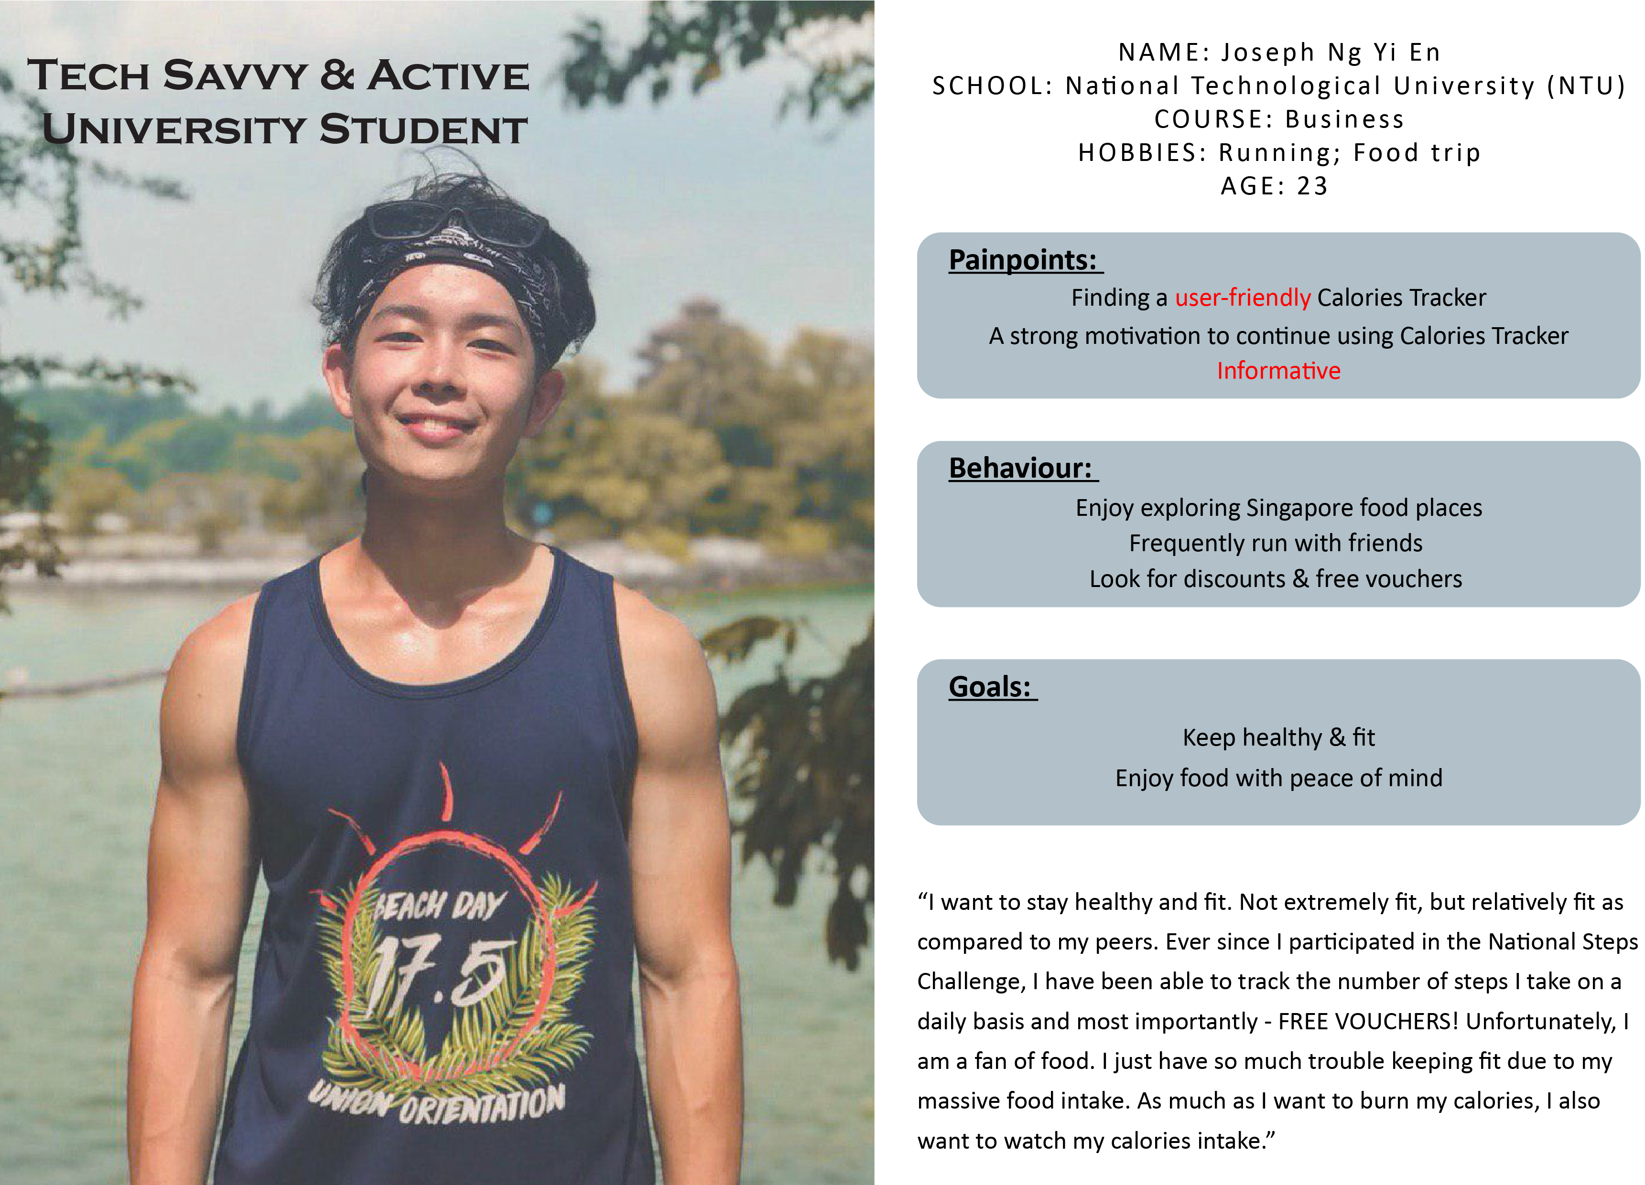
PERSONA INSIGHT HOW MIGHT WE DEMO SYSTEM EFFECTIVENESS VISION
Notes:
Jing Jie will tell his story here
Users/Customers
Tertiary students
Tech savvy adults
Health conscious individual
Pilot study: SUTD students
Food Vendors
Operates institution-based canteen
Comfortable with cashless payments and technology
Pilot study: food vendors in SUTD canteen

Slide 3
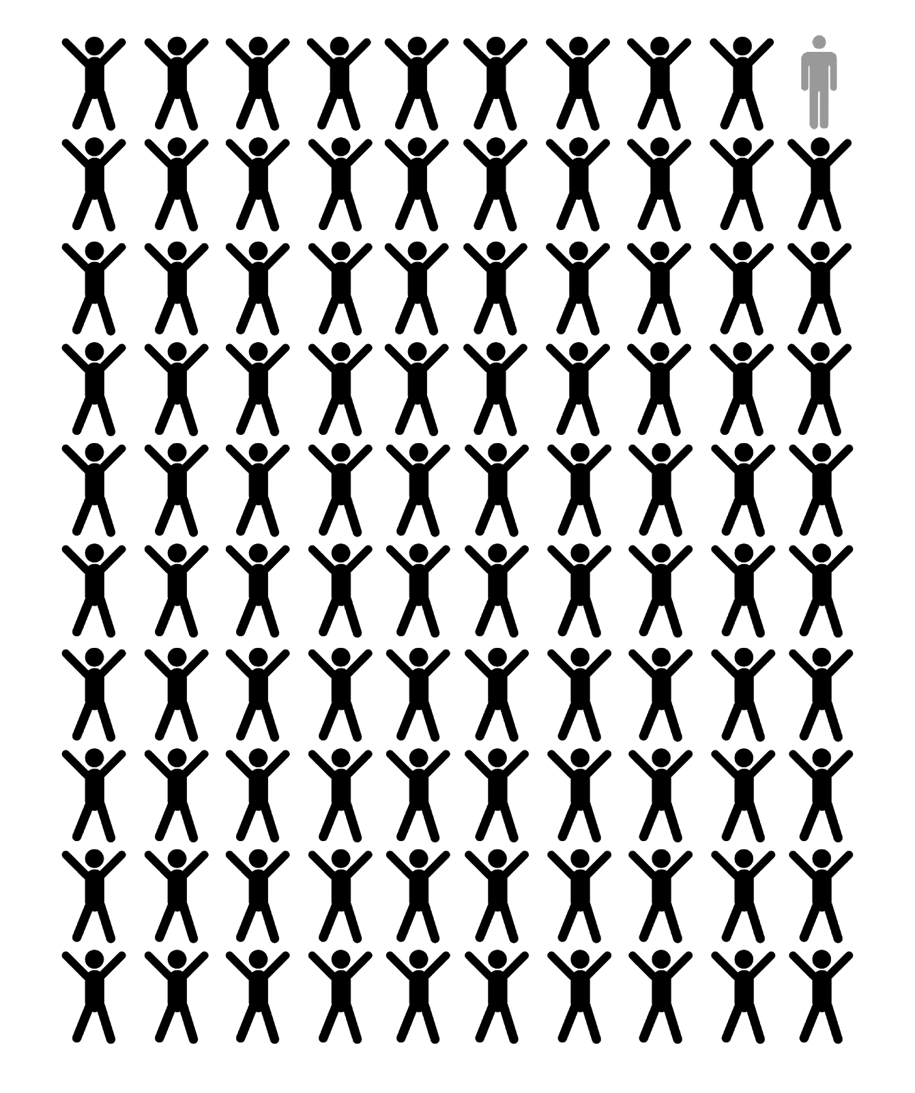
99% surveyed want to live a healthy lifestyle, BUT 70% find that tracking calories is too difficult!
PERSONA INSIGHT HOW MIGHT WE DEMO SYSTEM EFFECTIVENESS VISION
Notes:
More about problem statement
Current usage of Healthy 365

Slide 4
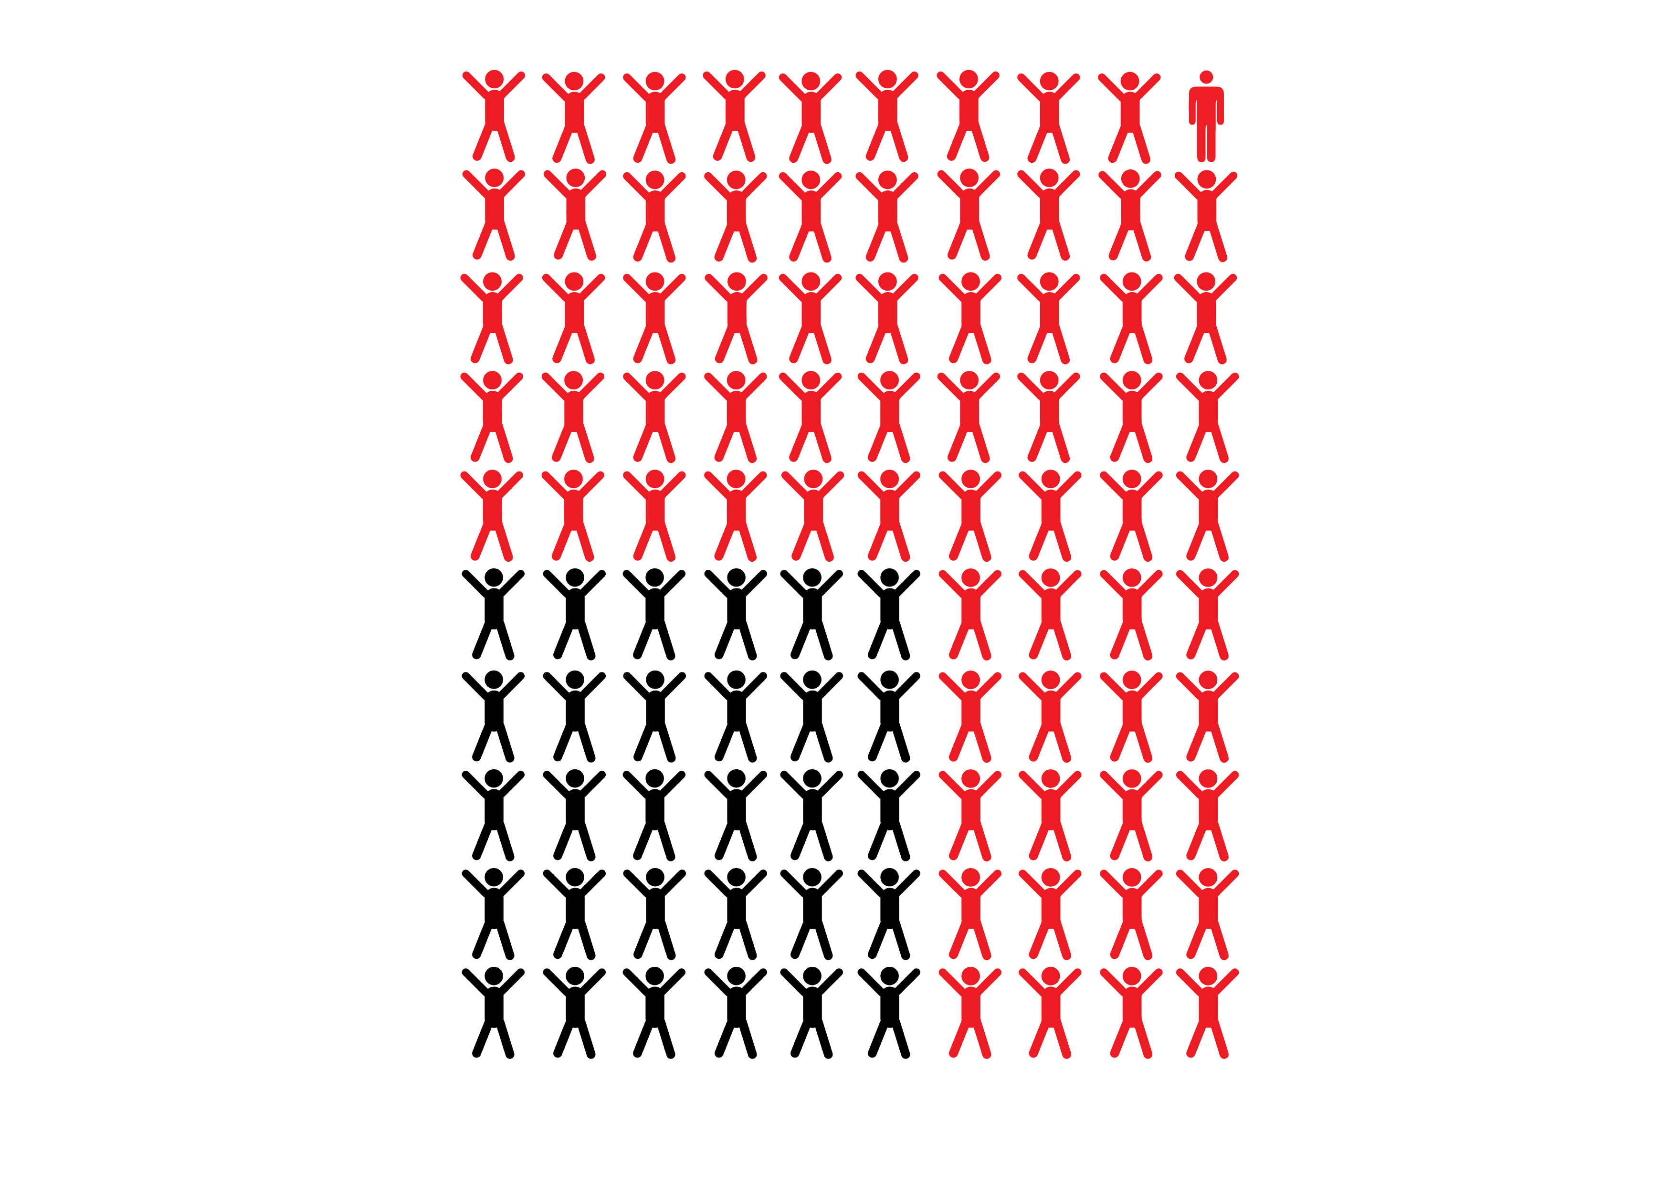
99% surveyed want to live a healthy lifestyle, BUT 70% find that tracking calories is too difficult!
PERSONA INSIGHT HOW MIGHT WE DEMO SYSTEM EFFECTIVENESS VISION
Notes:
More about problem statement
Current usage of Healthy 365

Slide 5

How might we track calories as effortlessly as possible?
PERSONA INSIGHT HOW MIGHT WE DEMO SYSTEM EFFECTIVENESS VISION
Notes:
Example, can be improved
Easy to trace food intake (calories) accurately
NoCalories APP?
Good to be part of the ordering process
Possible solution
Integrating with existing PayLah app/Healthy 365
2 transactions in 1 go - payment + calories

Slide 6

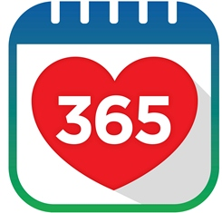
Bridge
DBS Paylah & Healthy365
PERSONA INSIGHT HOW MIGHT WE DEMO SYSTEM EFFECTIVENESS VISION

Slide 7


Convenient!
Accurate!
User
Vendors
PERSONA INSIGHT HOW MIGHT WE DEMO SYSTEM EFFECTIVENESS VISION
Notes:
Example, can be improved
Demo for user side done here, vendor demo Q&A or if there is time

Slide 8
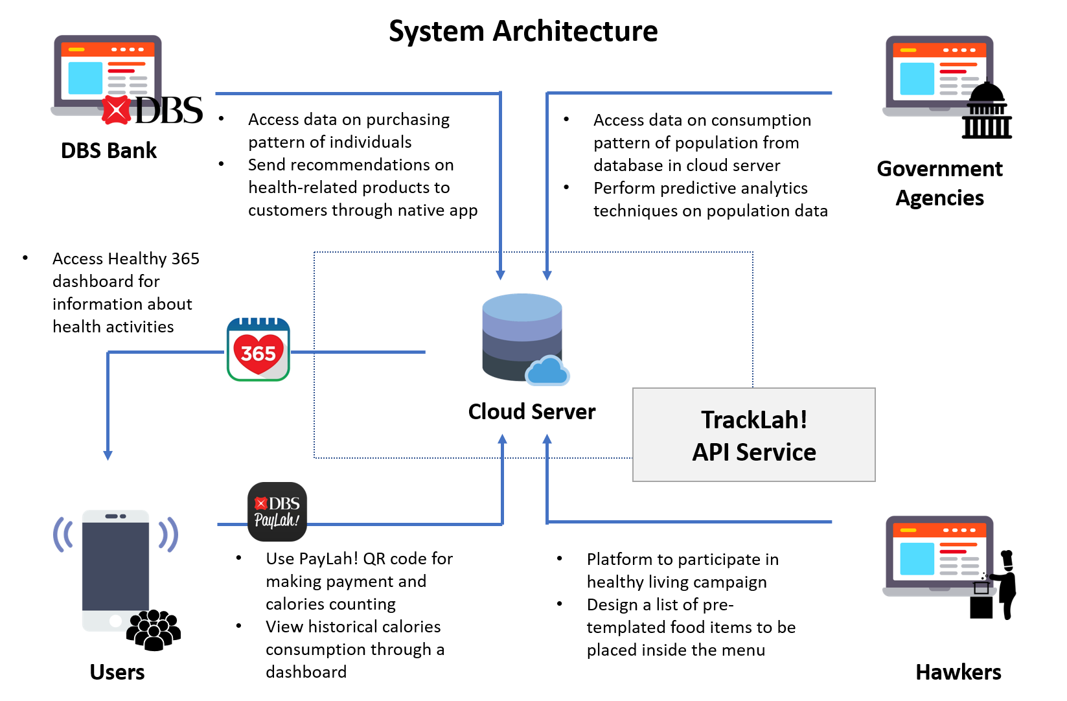
PERSONA INSIGHT HOW MIGHT WE DEMO SYSTEM EFFECTIVENESS VISION
Notes:
Proposed System Architecture

Slide 9





86% would use it if there is certain form of incentives, ease of use and informative
Acquire consumption pattern to promote health products
Students
DBS
Study chronic disease patterns and take pre-emptive actions
85% would adopt this if it could attract more customers
Institutional canteen vendors
Government
PERSONA INSIGHT HOW MIGHT WE DEMO SYSTEM EFFECTIVENESS VISION
Notes:
Can include the stats under each of the image if desired
I think we should talk more about the pilot study here:
Government agencies are willing to open up (HPB)
SUTD canteen vendors are more open to participate after trying Samson’s app
67% of students surveyed use cashless payment and are willing to try the app
OTHER STATS:
Why people do not track calories (lazy)
60.4% think tracking calories is important
66.7% use cashless payments
Why people gave up using health apps
What would incentivise you to use health applications?
83.6% would use calorie tracking if seamlessly integrated

Slide 10
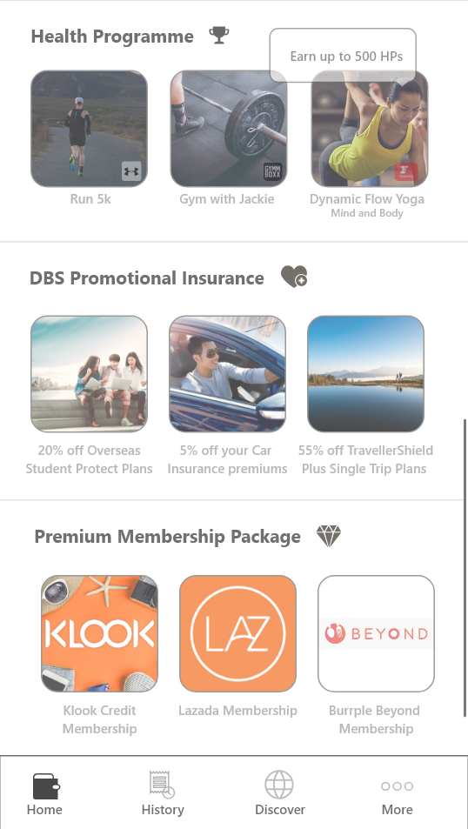


















































Lifestyle App:
Paving the way for endless possibilities
PERSONA INSIGHT HOW MIGHT WE DEMO SYSTEM EFFECTIVENESS VISION
Notes:
To pacify stakeholders

Slide 11
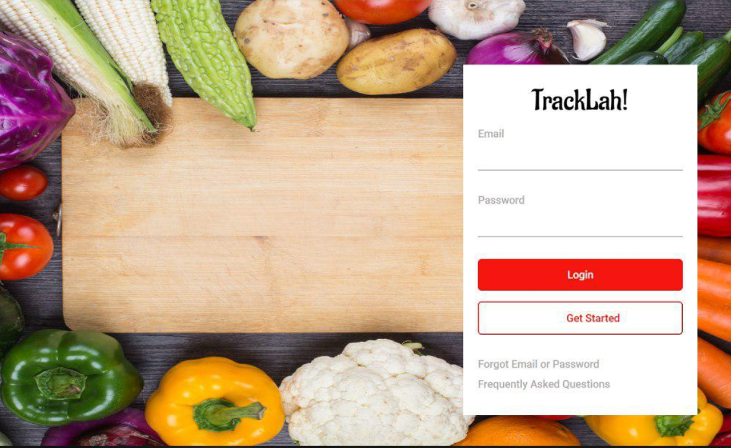
Annex: Prototype of TrackLah!Vendors for survey

Slide 12

Annex: Prototype of DBS Paylah! for public survey

Slide 13
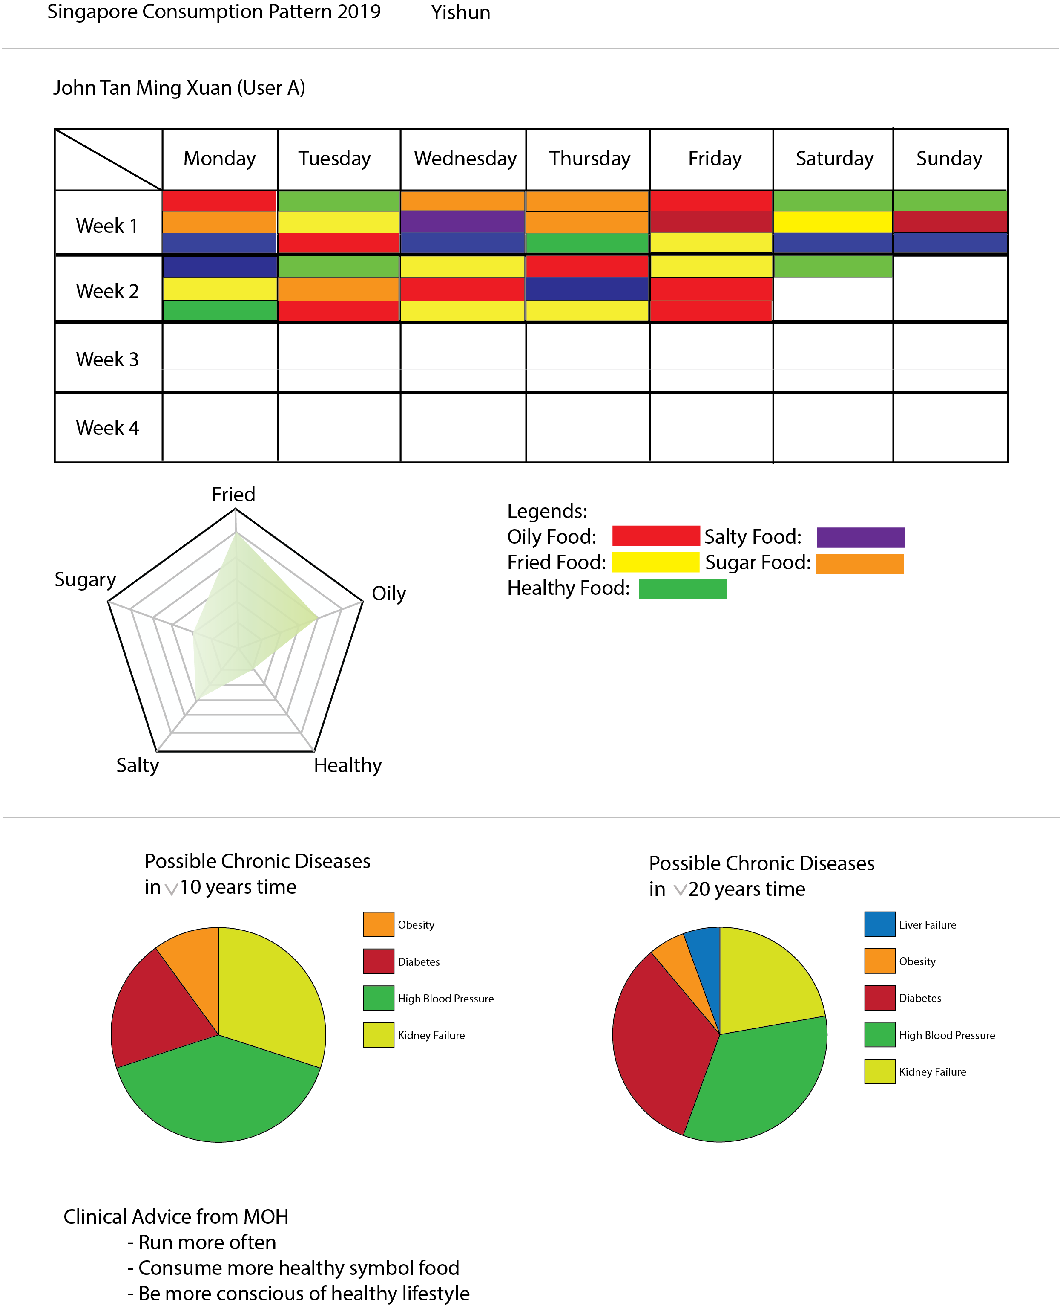
Annex: TrackLah! Data Set
Daily food consumption statistics for USER:
Food preferences
Possible Chronic Diseases
Clinical Advice from MOH

Slide 14
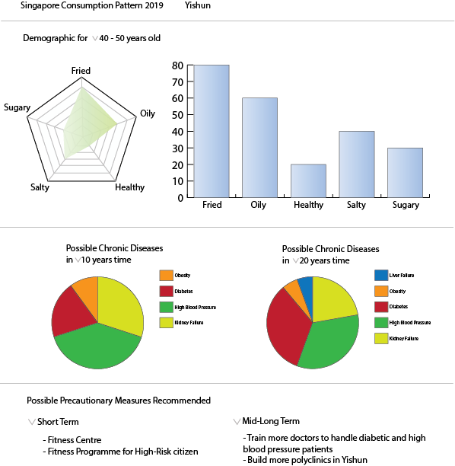
Annex: TrackLah! Data Set
Daily food consumption statistics for HPB:
Food preferences of certain district
Possible Chronic Diseases of certain district
Precautionary measures that can be taken

Slide 15
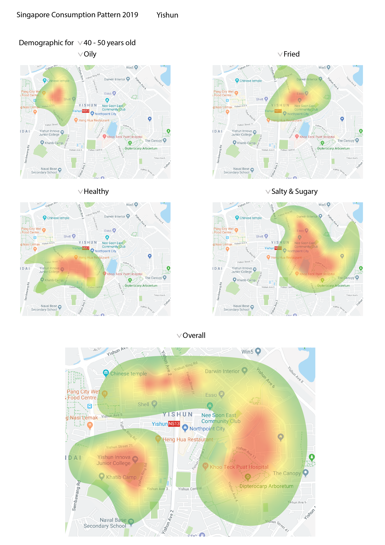
Annex: TrackLah! Data Set
Food Consumption Pattern statistics for HPB:
Specified type of food mostly consumed at

Slide 16
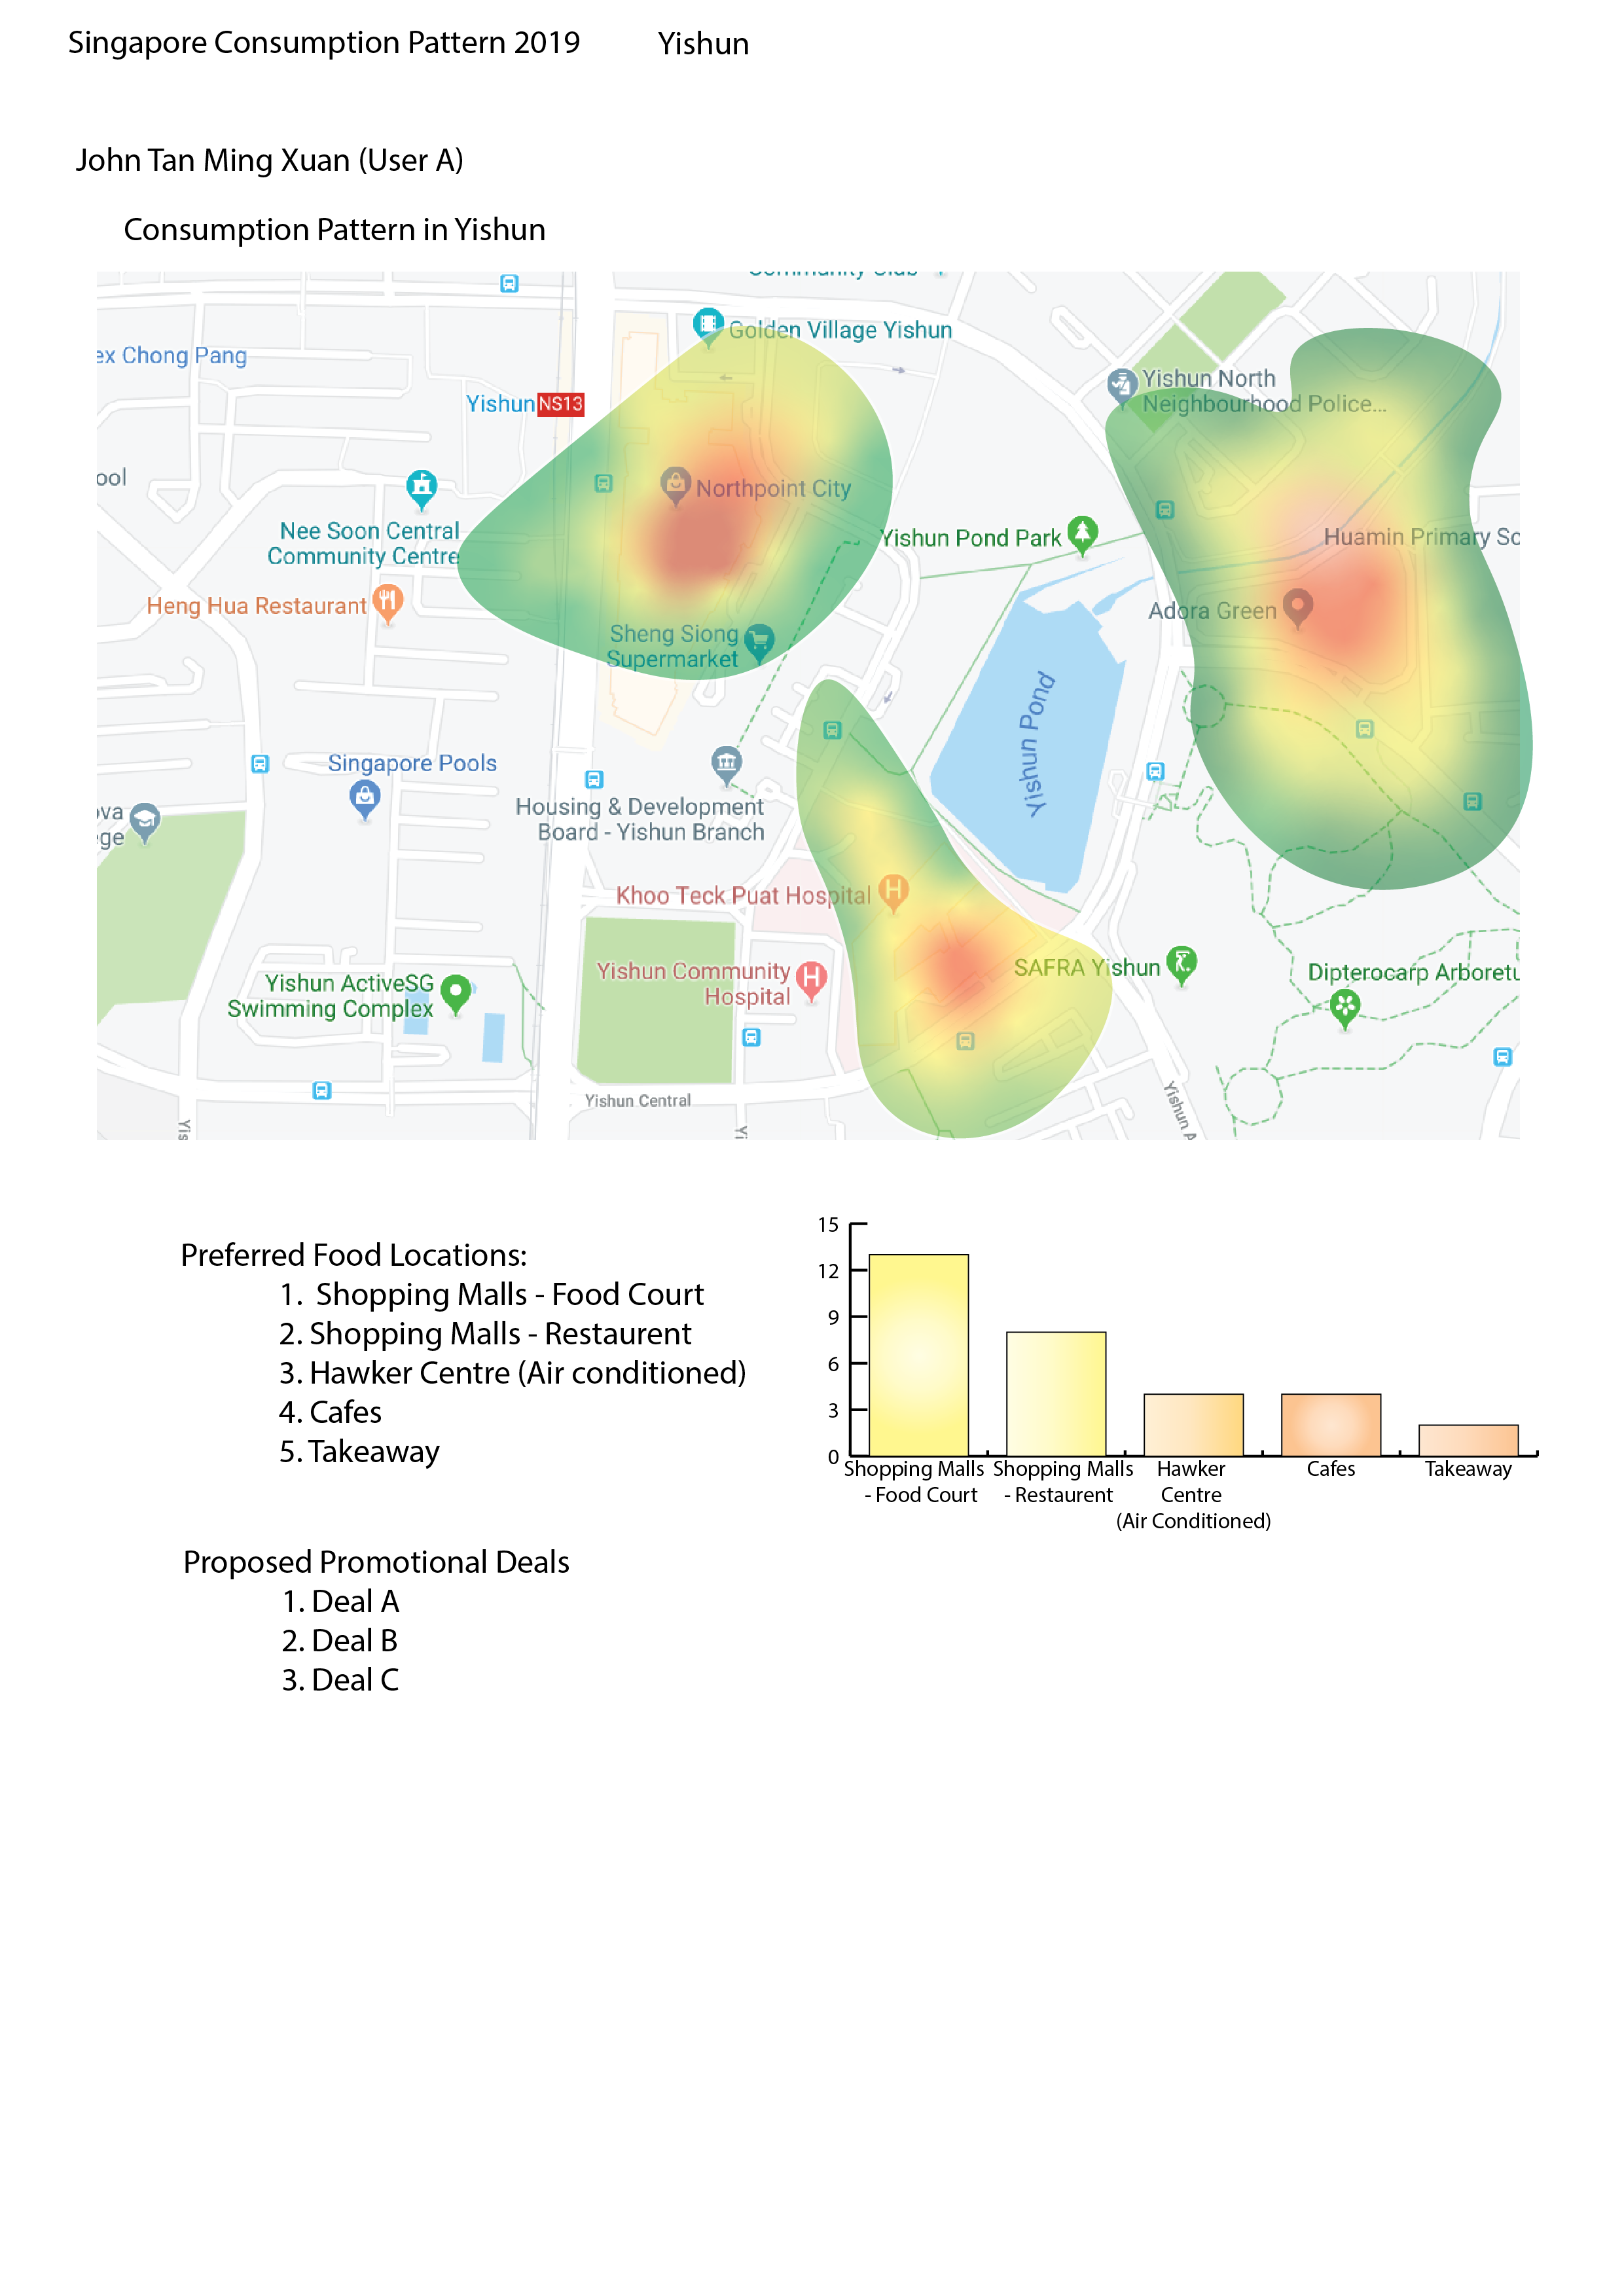
Annex: TrackLah! Data Set
Daily consumption pattern statistics for Bank:
Preferred location to dine in
Frequency of dining location
Recommended promotional deals

